Slide 1
Health and housing partnerships
[Name] [Job title / organisation]

Slide 2
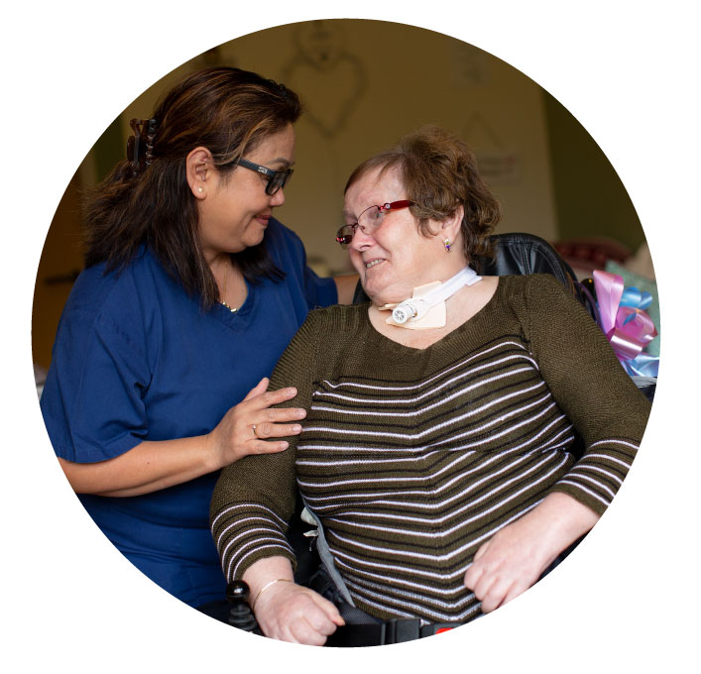
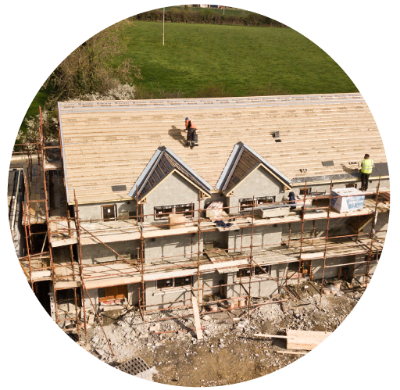
Health and housing partnerships
Today
the impact of good housing on health outcomes
reflections on how we might continue to strengthen these partnerships

Slide 3

The impact of housing on health:
Home and services
A good quality home improves people’s health
People in homes that lack necessary adaptations are between 1.5 and 2.8 times more likely to suffer a fall than those where interventions are in place
39% fewer hospital admissions for cardiorespiratory conditions and injuries in those with upgraded houses
3.9% reduction in GP visits for respiratory conditions for home energy improvement beneficiaries (compared to a 9.8% increase in the control group)

Slide 4
The impact of housing on health:
Home and services
A good quality home saves the NHS money
Poor housing costs the NHS in Wales £95m/year in treatment costs
For each person living in housing with care settings, the financial benefit to the NHS was approximately £2,000 per person per annum
For every £1 spent on adaptations, prior to hospital discharge, there is a saving of £7.50 for health and social care
Preventing homelessness can result in savings of c.£9,266 per person, vs allowing homelessness to persist for 12 months
We are paying for crisis care rather than prevention. Of the 50%+ of Welsh Govt budget allocated to health, 74% is directed to acute services

Slide 5
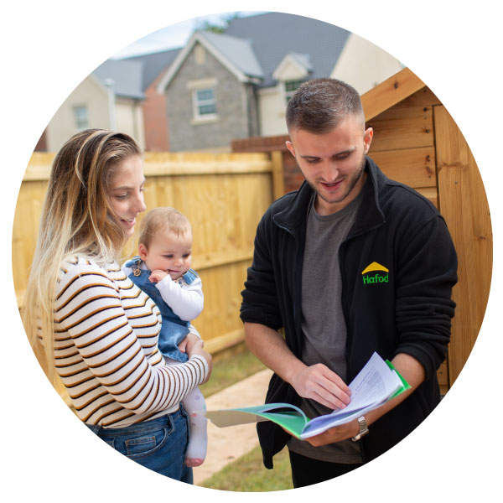
The impact of housing on health:
Sharing our resources
Housing associations are rooted in place and communities
Health inequality is not random. Reducing poverty matters and makes a real difference
By sharing our unique resources, assets and local insight we can amplify the efforts of our partners
We can support health and social care partners to increase their reach to communities and improve outcomes for individuals

Slide 6
Health and housing partnerships
Example: increasing vaccine take up in Butetown, Cardiff, June 2021
Ethnically diverse area, high levels of deprivation
Concern about lower take-up of vaccine amongst residents
Partnership with Muslim Doctors Cymru and local community leaders to deliver a local drop-in vaccine session
3 local HA supported through appropriate local space, staff, communication channels with residents, supporting logistics i.e.: booking system

